Slide 1





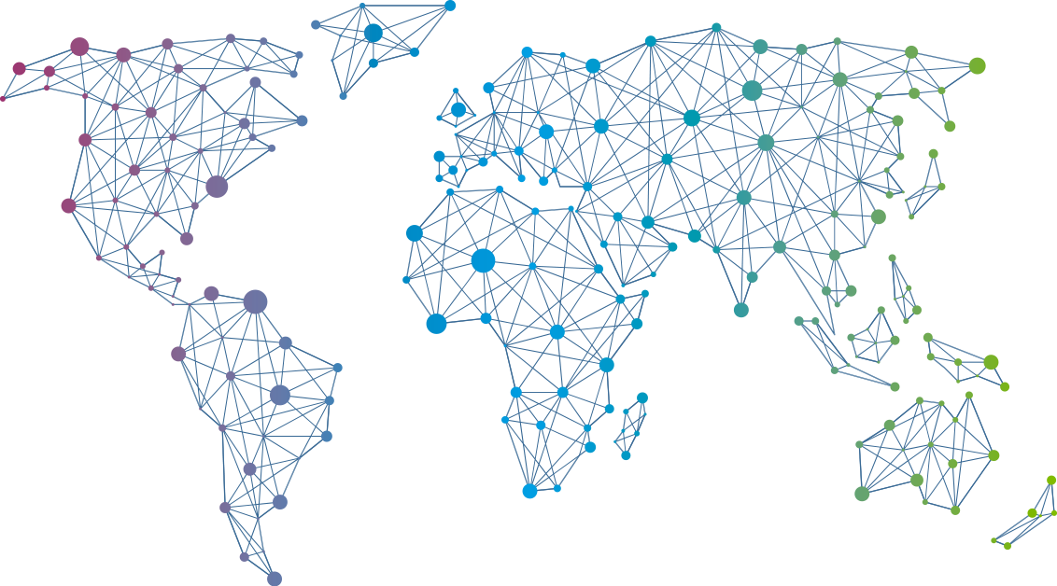

Speaker
Tim Davis
Pitfalls of Infrastructure as Code (And how to avoid them!)
Tim Davis
vtimd
September 16th & 17th
^{Online Event}
Powered By
International Conference

